Slide 1

Gas Exchange
Chapter 11

Slide 2
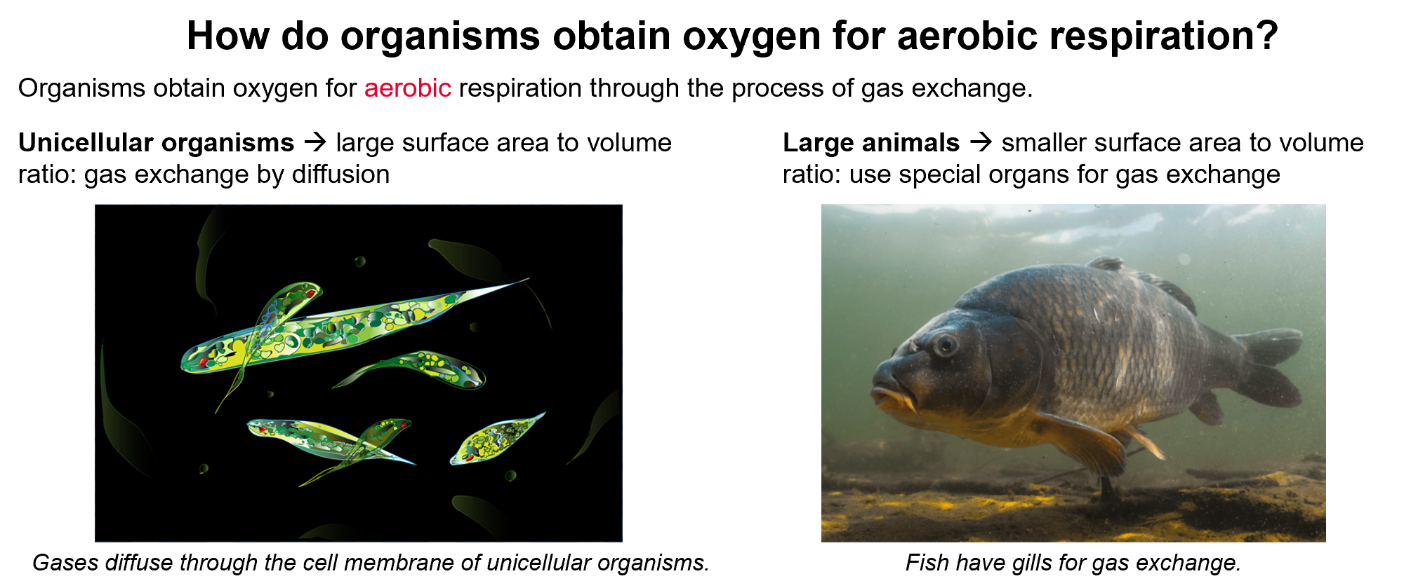

Slide 3
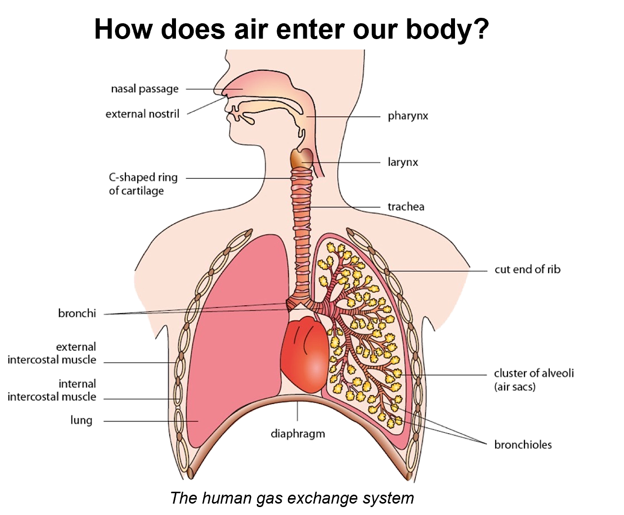

Slide 4
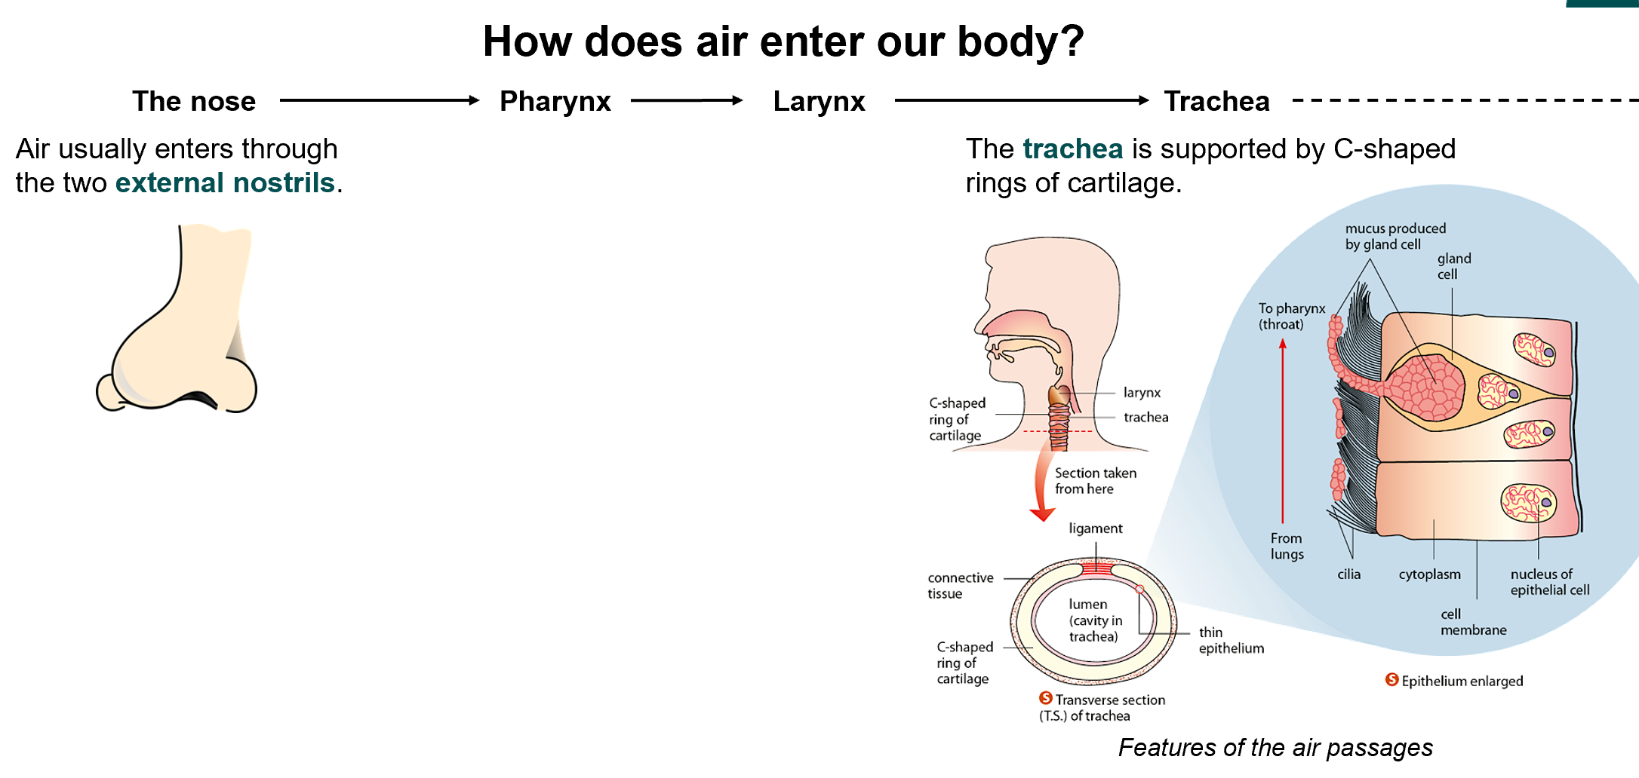
N.B.Cartilage keeps the lumen of the trachea open

Slide 5
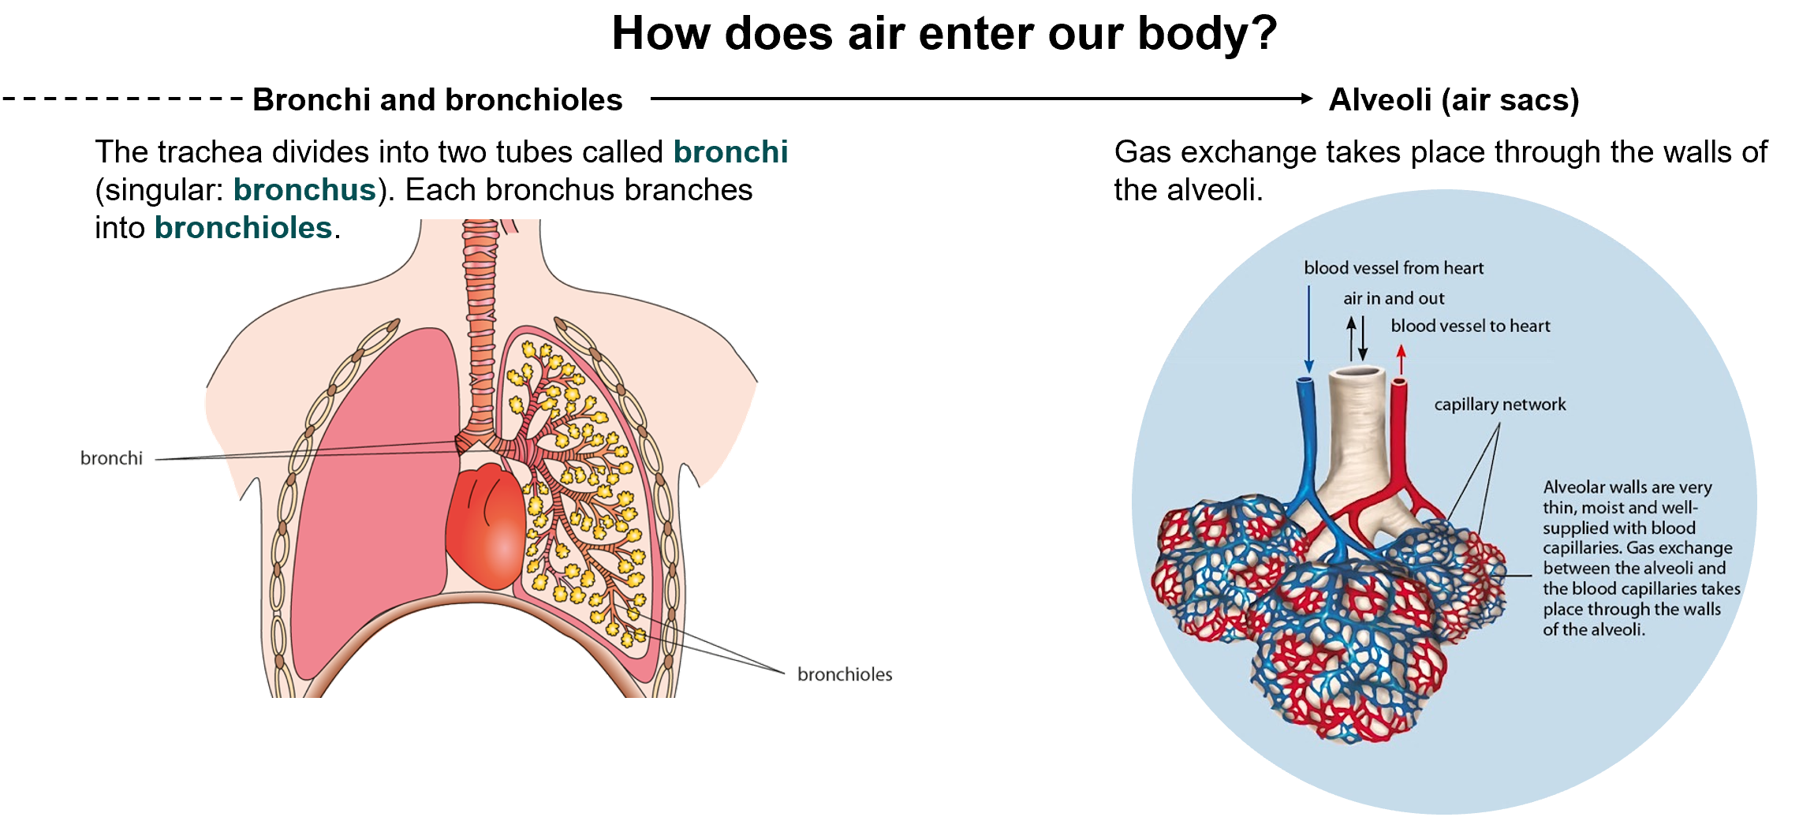

Slide 6
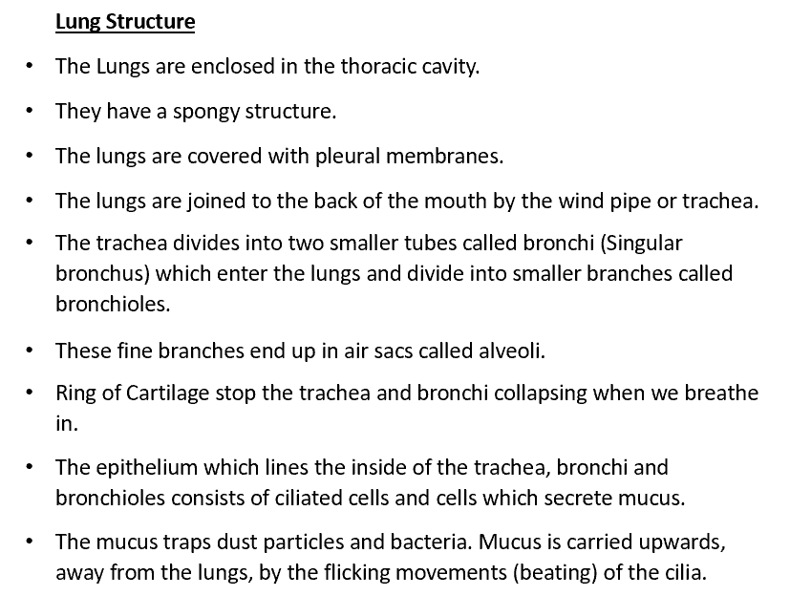

Slide 7
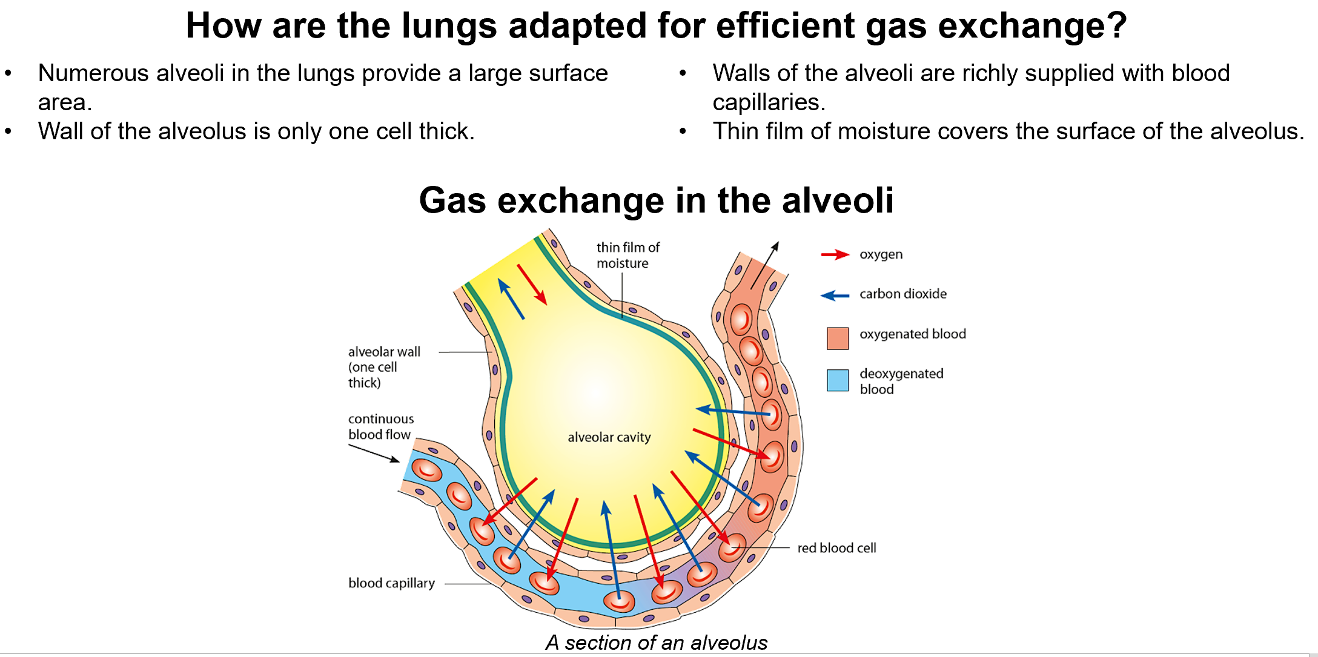

Slide 8
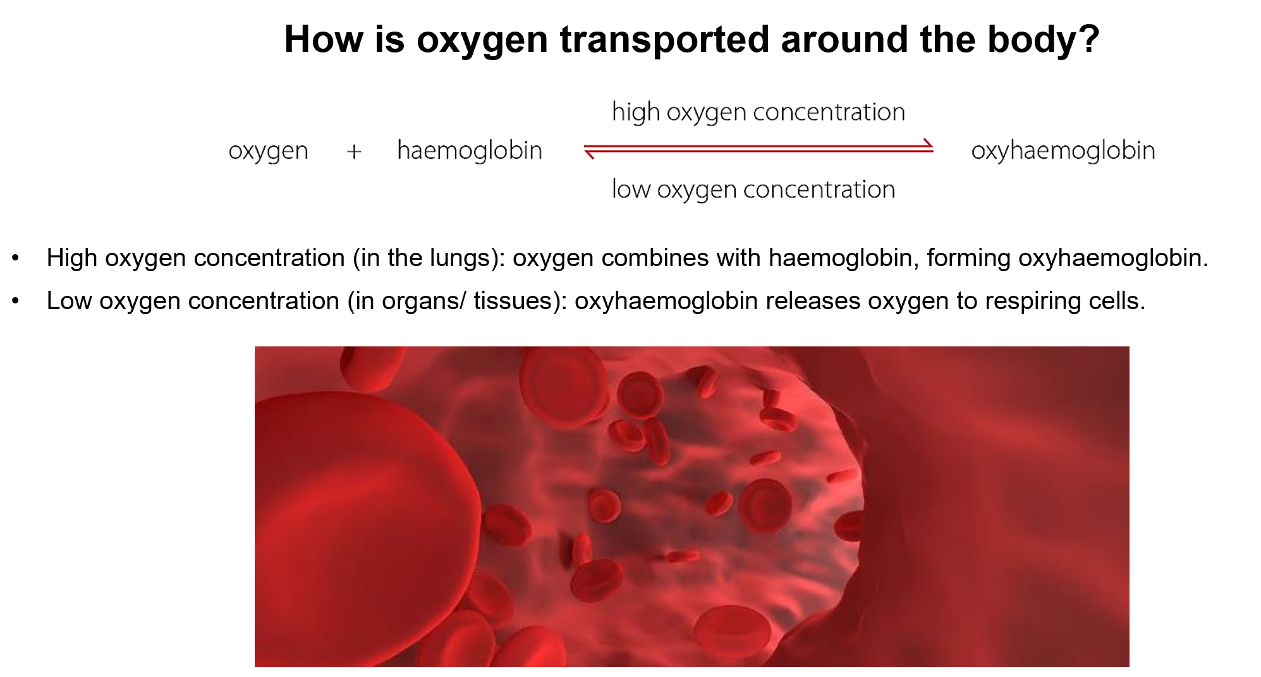

Slide 9
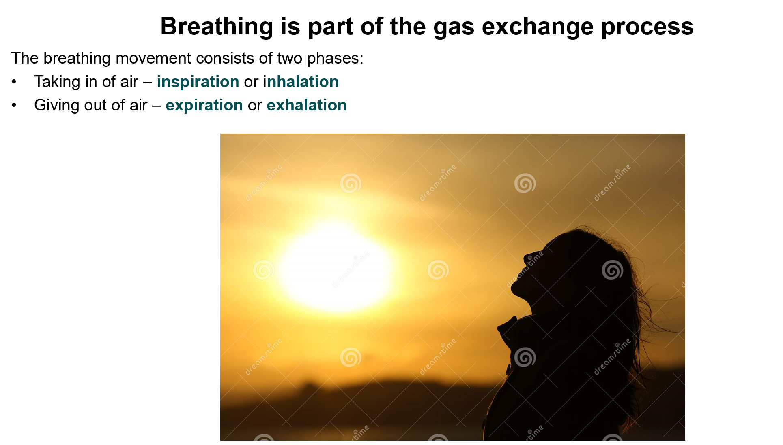


Slide 10
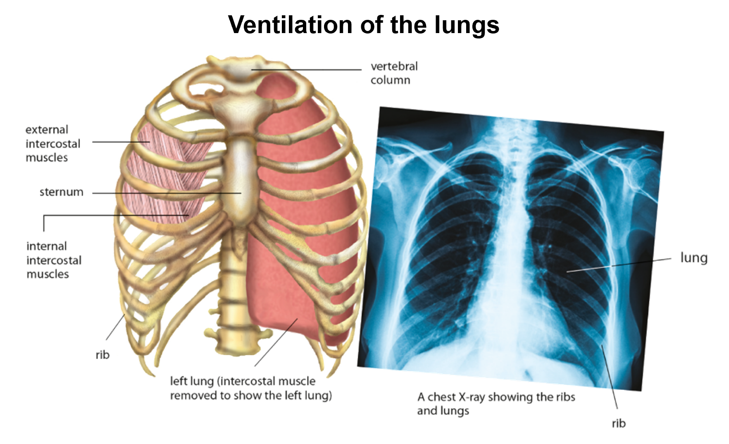

Slide 11
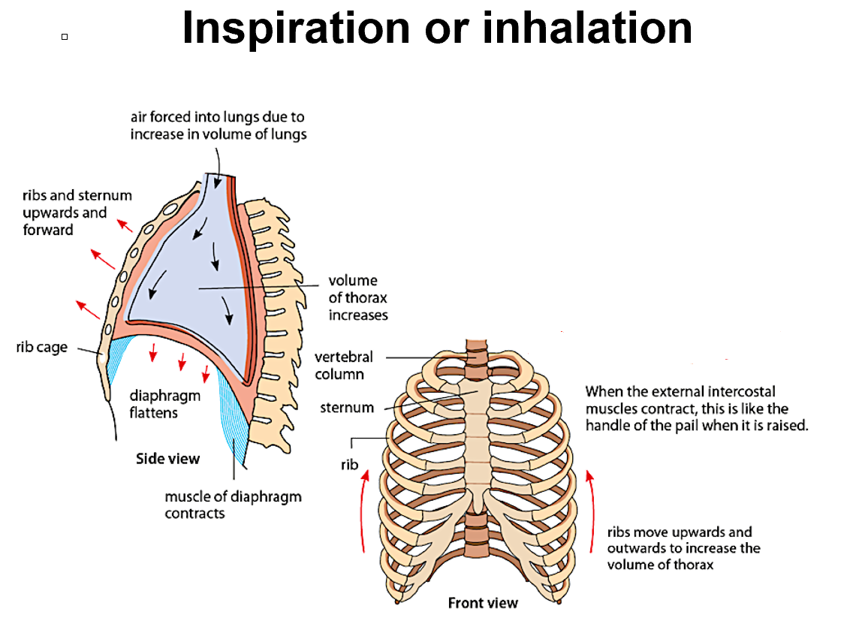

Slide 12
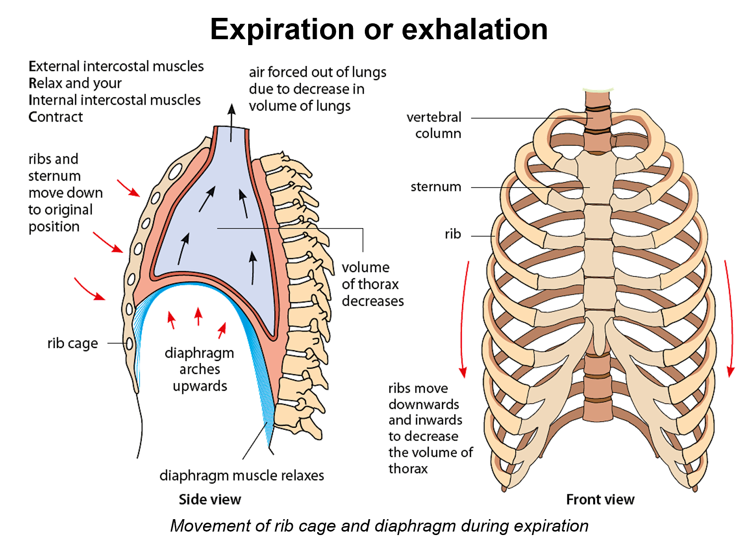

Slide 13
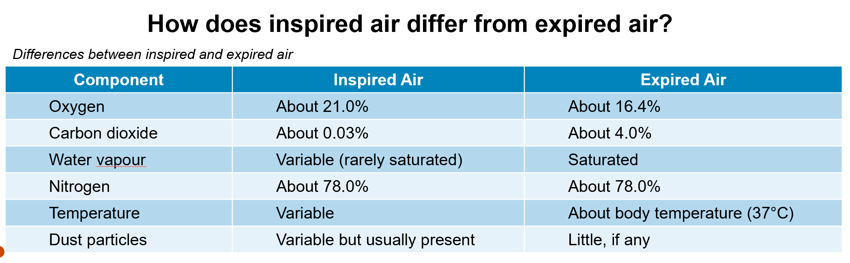

Slide 14
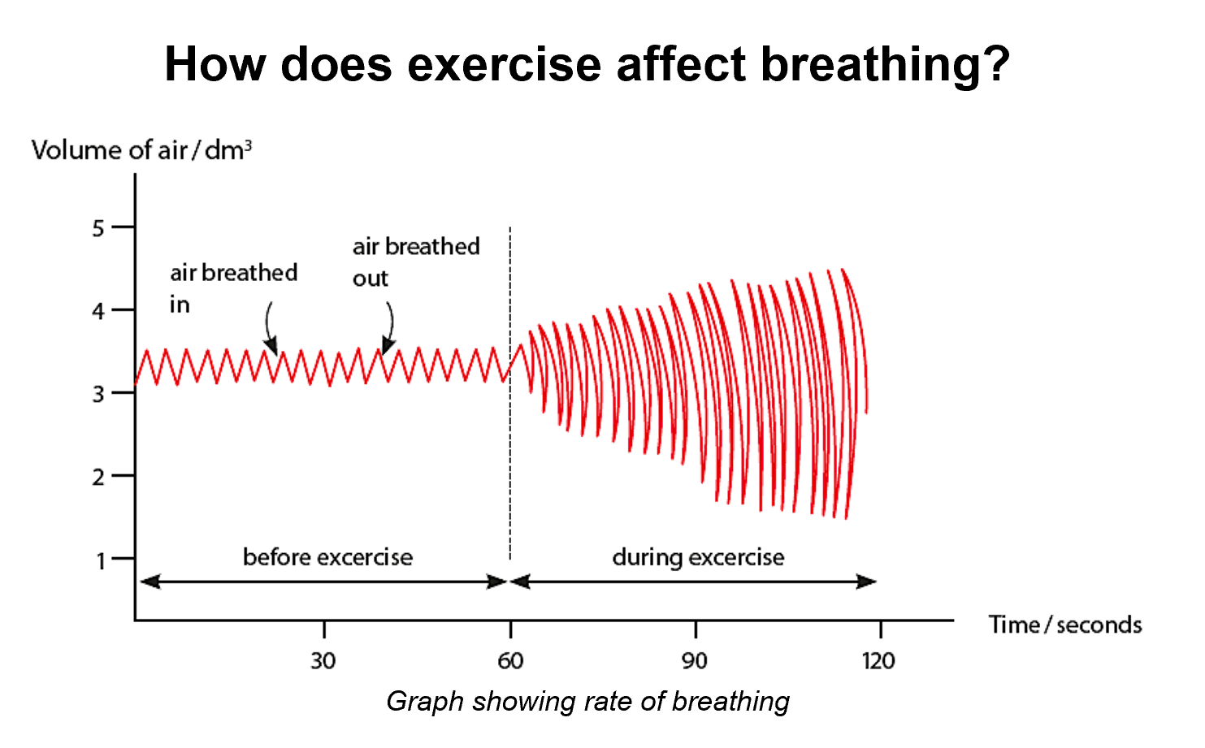
Breathing Rate
The number of inhalations and exhalations per minute at rest is about 16 times.
The number of inhalations and exhalations per minute during exercise is about 40 times.
Exercise and breathing rate
During exercise the muscles work hard, and need to release more energy by respiration. Greater volumes of air must therefore be breathed in and out, by:
Increasing the breathing rate – more breaths per minute.
Increasing the volume of air breathed in and out per breath - more air per minute

Slide 15
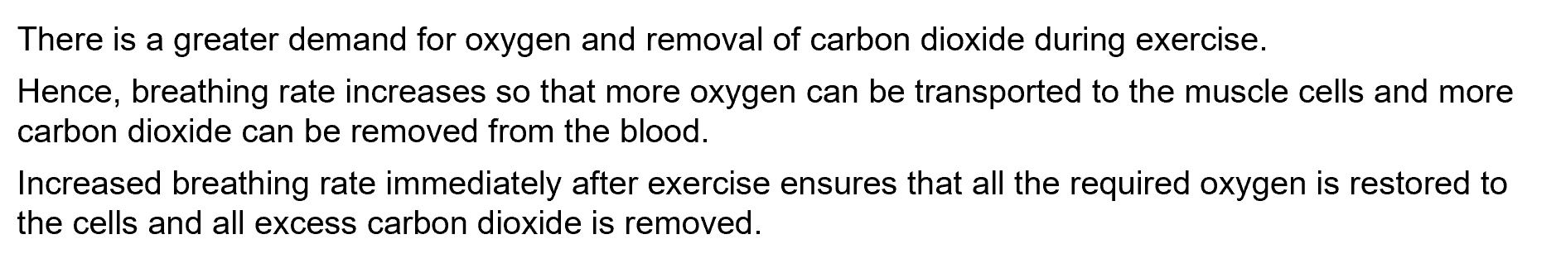

Slide 16
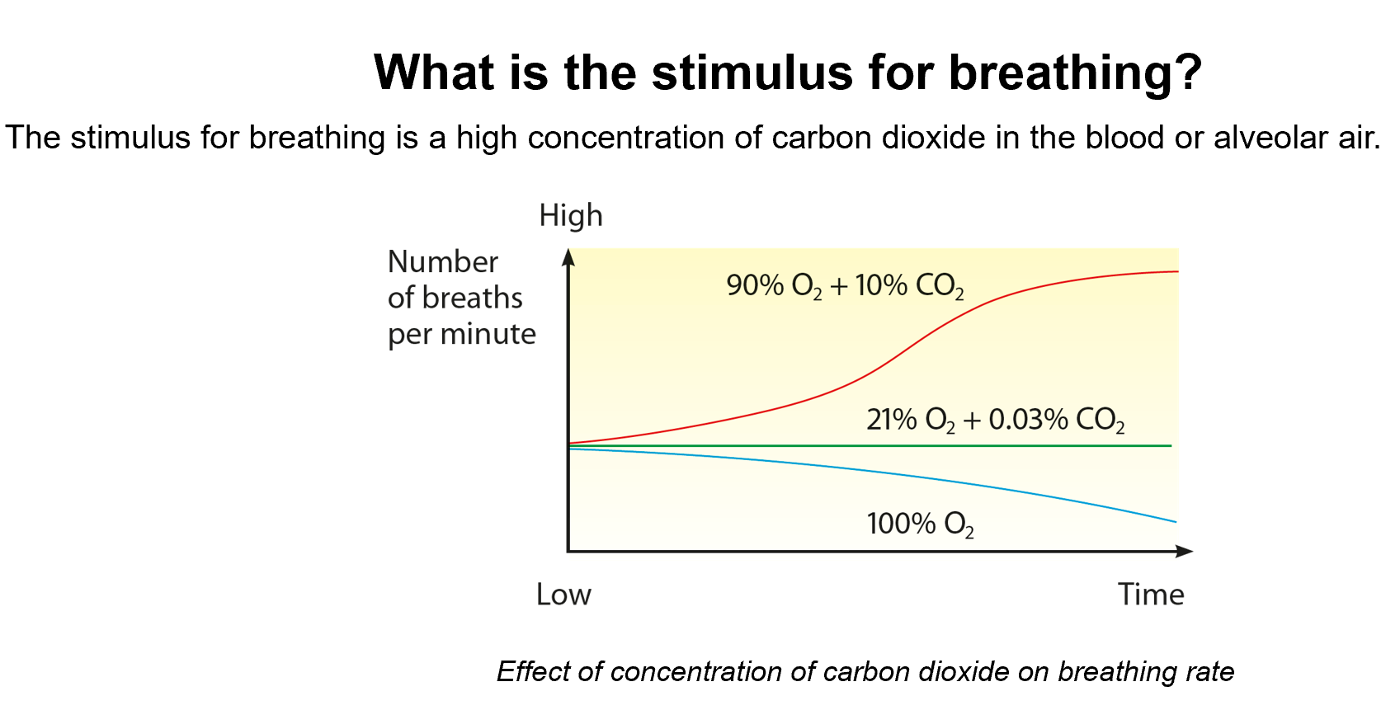

Slide 17
What stimulates increased breathing during exercise?
During Vigorous exercise:
Rate of aerobic respiration increases, so more CO2 released into blood stream
High CO2 stimulates the respiratory center in brain
Impulses from brain are transmitted to stimulate breathing organs to increase the rate of breathing
As a result:
The carbon dioxide is removed faster.
Allow more oxygen to dissolve in the blood and supply the active muscles

Slide 18
Effects of tobacco smoke and air pollution on gaseous exchange structures
Short term effects of tobacco smoke
Bronchioles constrict;
Cilia lining air passages stop beating;
Lining produces more mucus.

Slide 19
Long term effects
Chronic bronchitis
Tar in smoke stops beating of cilia in the air passages and also excess of mucus collects in the bronchi and bronchioles.
Mucus is a suitable medium for bacteria to grow and reproduce. This leads to inflammation known as bronchitis.
Emphysema
It is breakdown of alveoli. Tar in tobacco smoke makes alveoli weak as some phagocytes attack the elastic fibers of the alveoli and damage them.
The loss of elastic fibers makes it difficult to move air out of the lungs. The air remains in the lungs and is not refreshed during ventilation.
Coughing bursts, the weak alveoli.
This reduces the absorbing surface, and less oxygen diffuses into the blood, so the smoker with least exertion feels himself breathless and exhausted.
Lung Cancer
Tar causes change (mutation) in the structure of DNA in the epithelial cells in the air passages/lungs. Cancerous cells divide rapidly out of control and form a tumor.
Experimental evidence shows that tumours develop in animals exposed to cigarette smoke.
Carcinogens have been identified in tar.

Slide 20
Effect of Carbon Monoxide
Carbon monoxide is very poisons and can kill if inhaled in large amounts, How?
Carbon monoxide can combine with haemoglobin to form a stable compound called carboxyhaemoglobin.
This reduces the oxygen carrying capacity of the blood.

Slide 21
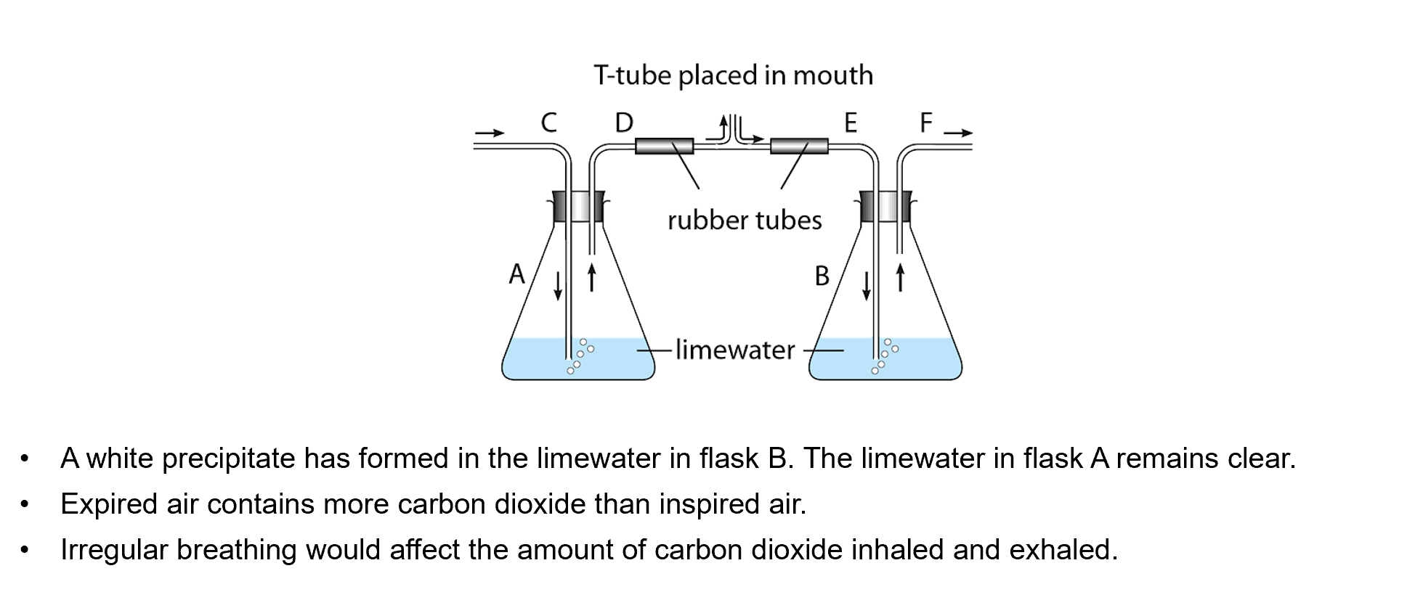
Carbon dioxide in exhaled air

